Slide 1
Investment Competition
FE670-Group3
GuanZhuo Qiao, Ang Li, Shen Sheng

Slide 2
Content
1. Portfolio Overview
2. Investment Thesis
3. Graphic Representation
4. Case Example
5. Conclusion Of Portfolio

Slide 3
Portfolio Overview
Benchmark: MSCI US IMI Health Care 25/50 Index
Stock universe of portfolio: we focus on the 386 stocks in the MSCI US IMI Health Care 25/50 Index and selected 78 stocks from them to invest every adjustment time

Slide 4
Investment Thesis
Our strategy focus on the event-driven in the health care sector.
Based on our target, we select FDA announcement and some Financial ratios to be our factors.
Sort our stock universe from low to high, then equally divide them into five groups quarterly.
Allocate the weights to each group based on their factor performance.
Hold the stocks in group which has the highest value of the factor at each event time.
What's more, we assign the weight to each stock based on their corresponding factor values.

Slide 5
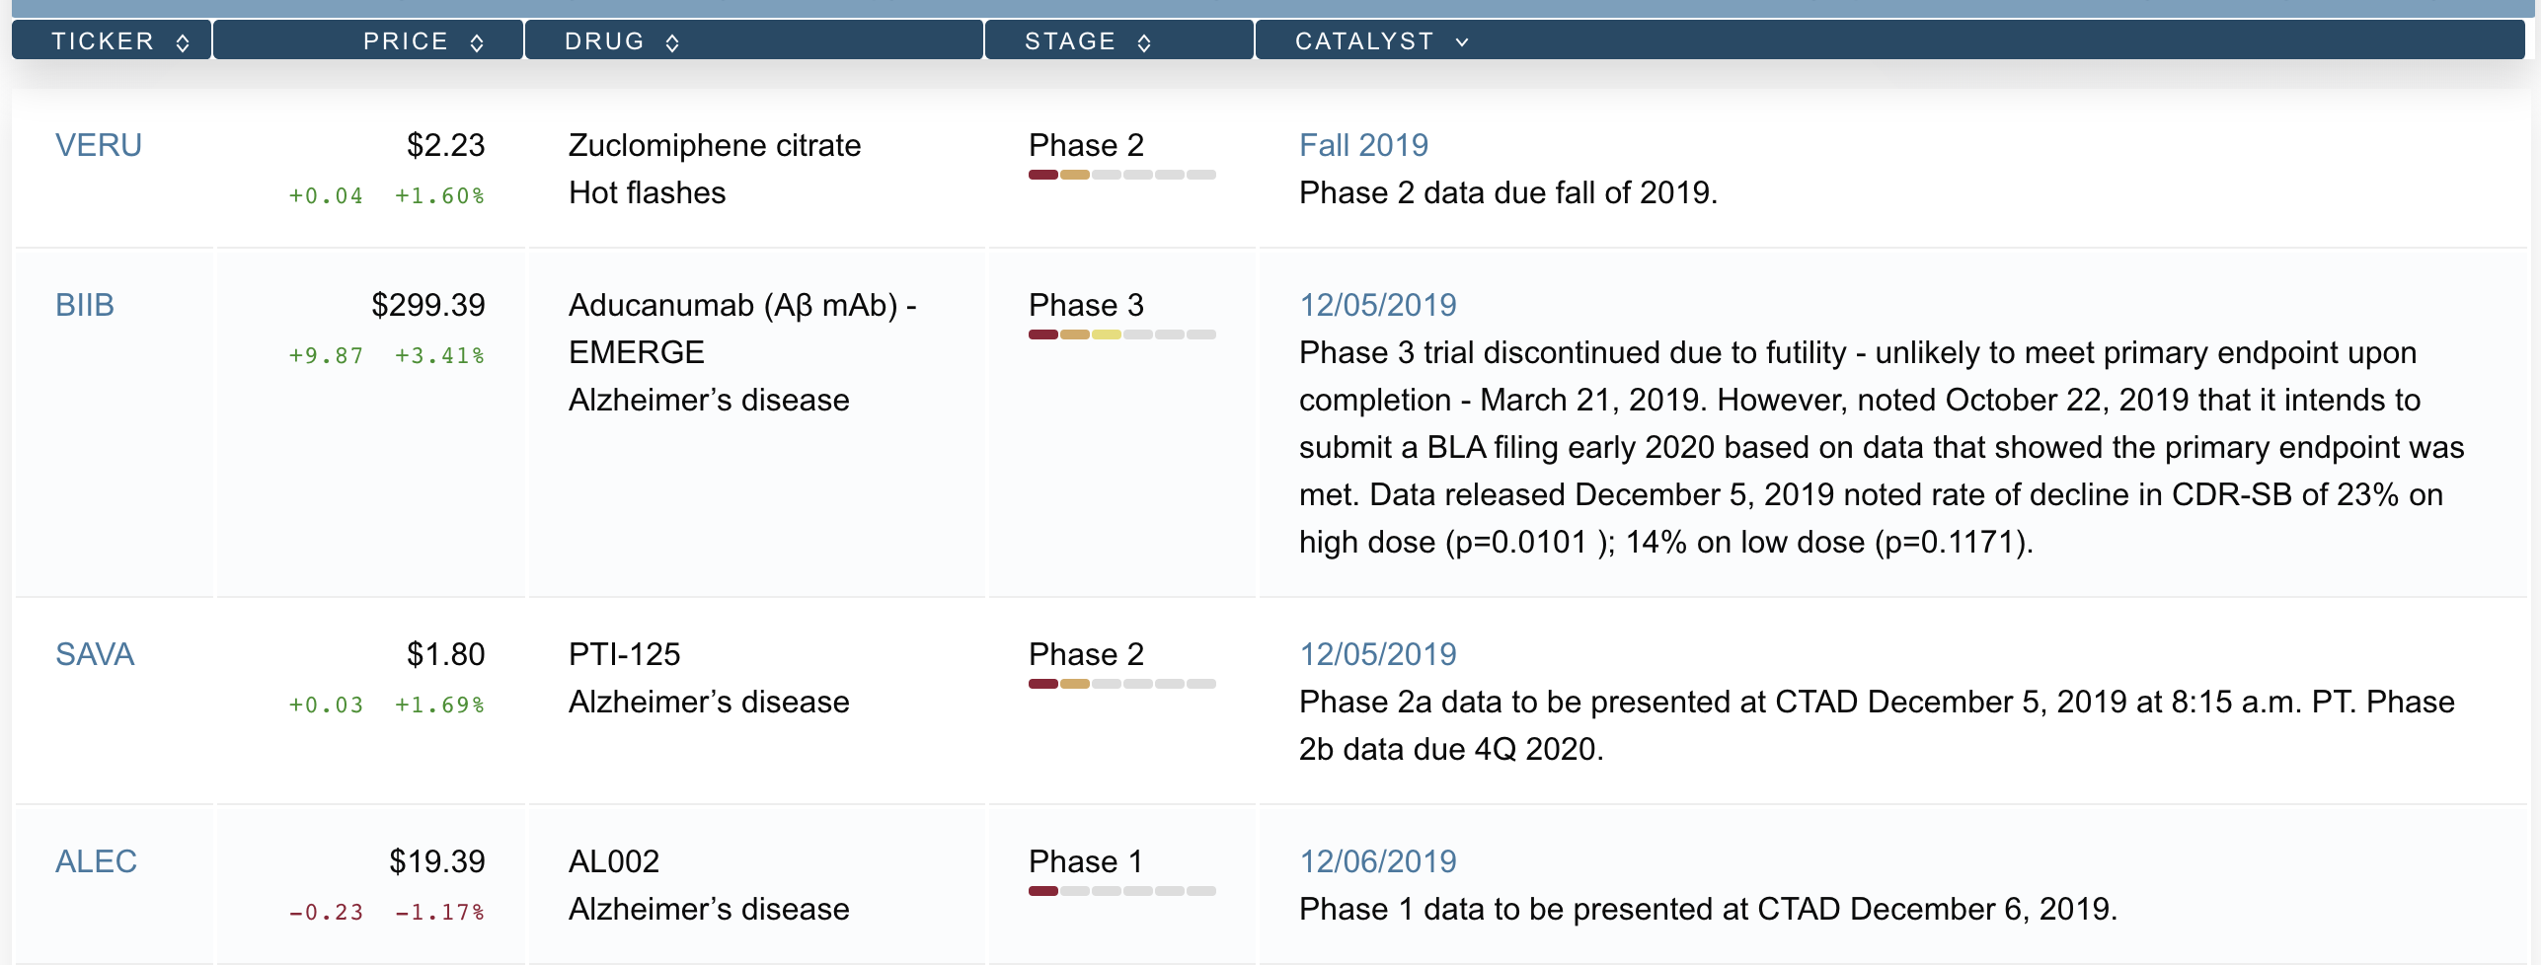
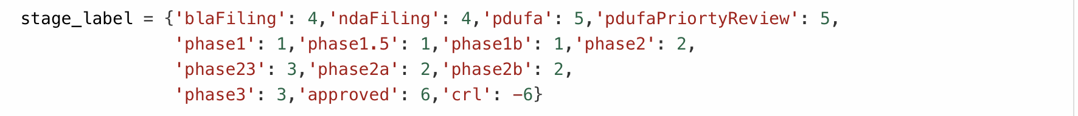
Factors Universe
We scrap the content of FDA announcement and Financial statement of each company from website
Dealing with all the factors and quantifiable them from 0 to +1
Example for dealing FDA factor:

Slide 6
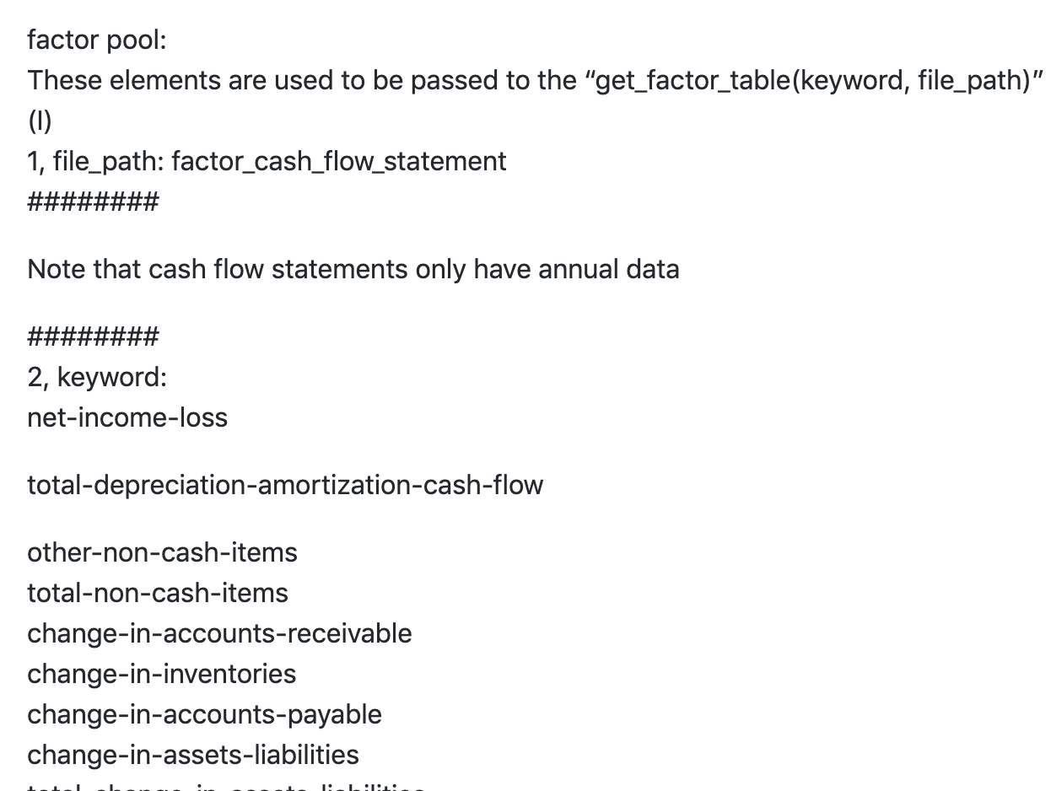
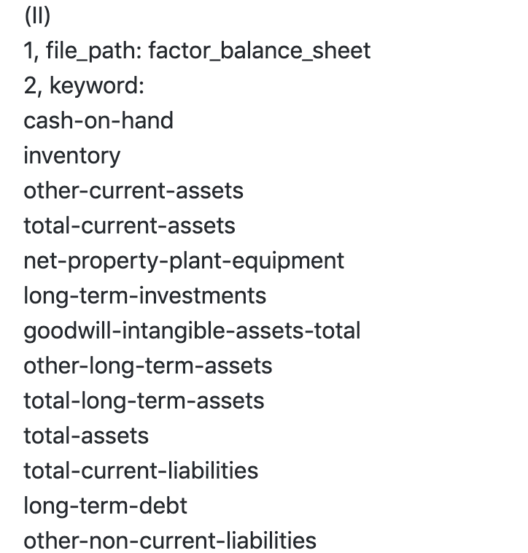
Factor of Financial Statement
All the data of factors were obtained from the website
'https://www.rttnews.com/CorpInfo/FDACalendar.aspx?PageNum=()’ and
'https://www.macrotrends.net/stocks/charts'.

Slide 7
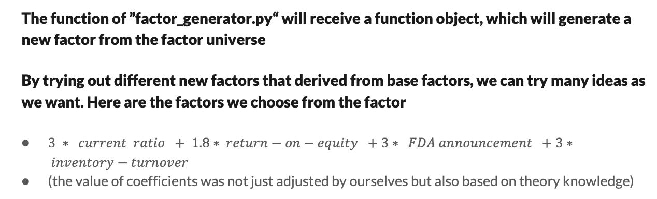
Build Our Robust Factor
The function of ”factor_generator.py“ will receive a function object, which will generate a new factor from the factor universe
By trying out different new factors that derived from base factors, we can try many ideas as we want. Here are the factors we choose from the factor
$3 ∗ current ratio + 1.8∗ return−on−equity +3∗ FDA announcement +3∗ inventory−turnover$
(the value of coefficients was not just adjusted by ourselves but also based on theory knowledge)

Slide 8
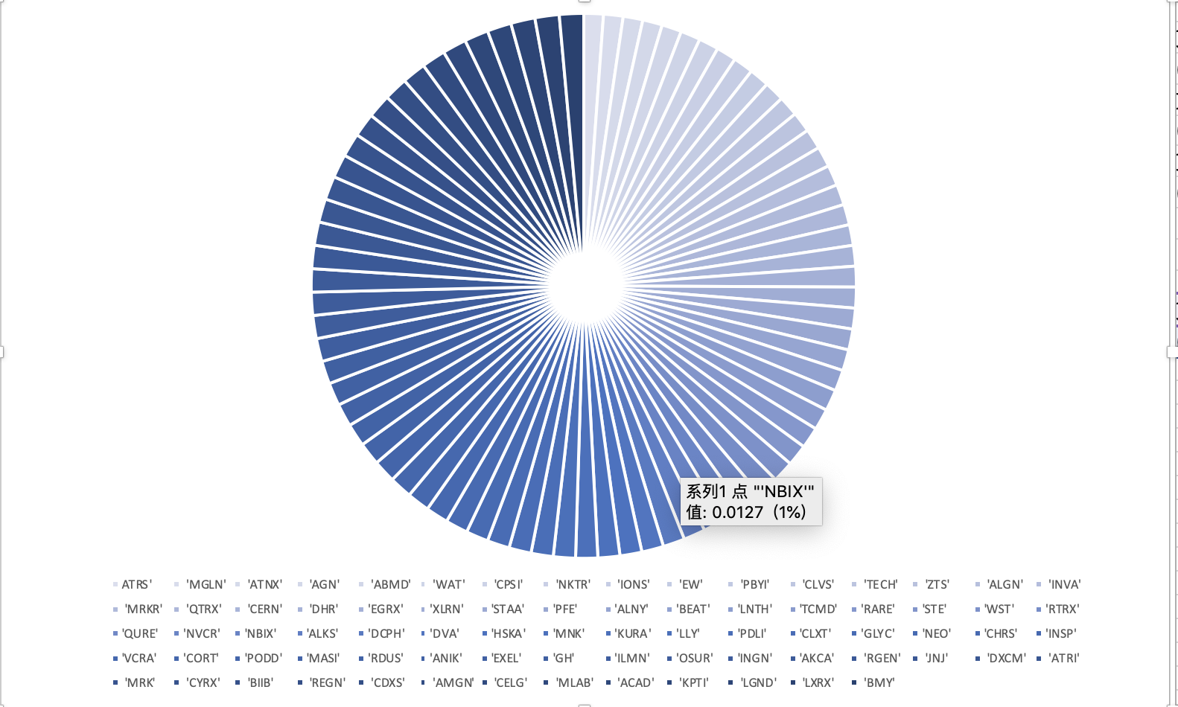
Portfolio Holdings At The Launch

Slide 9
Monotonic Test
From the monotonic graph, we know the cumulative returns of the 5 factors objective to the monotonicity through out the whole period. They separate from each other and never across to each other.
Notes:
Intersections crossection

Slide 10
Distribution and Outlier Detection
We can see the factors concentrate on 2 values, 4 and 5.5. This is because the FDA factors are discrete, and range from -6 to 6. Among the values, -6 represents the complete response letter, and the rest are from 1 to 6, which leads to a gap between 4 and 5.5 in the second graph.

Slide 11
Factor Portfolio vs Health Care Index
In the beginning, the performance of our portfolio is consistent with the IMI Health Care Index. But after 5 years, around 2014, our portfolio gets better performance, and gradually widens the gap. At the end of the period, the return drops down a lot but still be better than the index. The reason we believe is an unexpected drawback not caught by our factor.
While we can see the whole performance of our portfolio outperform the benchmark.

Slide 12
Information Ratio & Sharpe Ratio
Name | Information Ratio: | Sharpe Ratio:
G1 | -0.2807382761646767 | 0.2149509453117287
G2 | -0.08456284152769475 | 0.27323234713575273
G3 | 0.1917441441373163 | 0.3960268668110117
G4 | 0.249306228996819 | 0.43910713350564123
G5 | 0.3732786176207983 | 0.6541611213472358
As we can see, with the increase of our factor, the information ratio and Sharpe ratio both augment markedly, which brings the higher traditional risk-adjusted return.

Slide 13
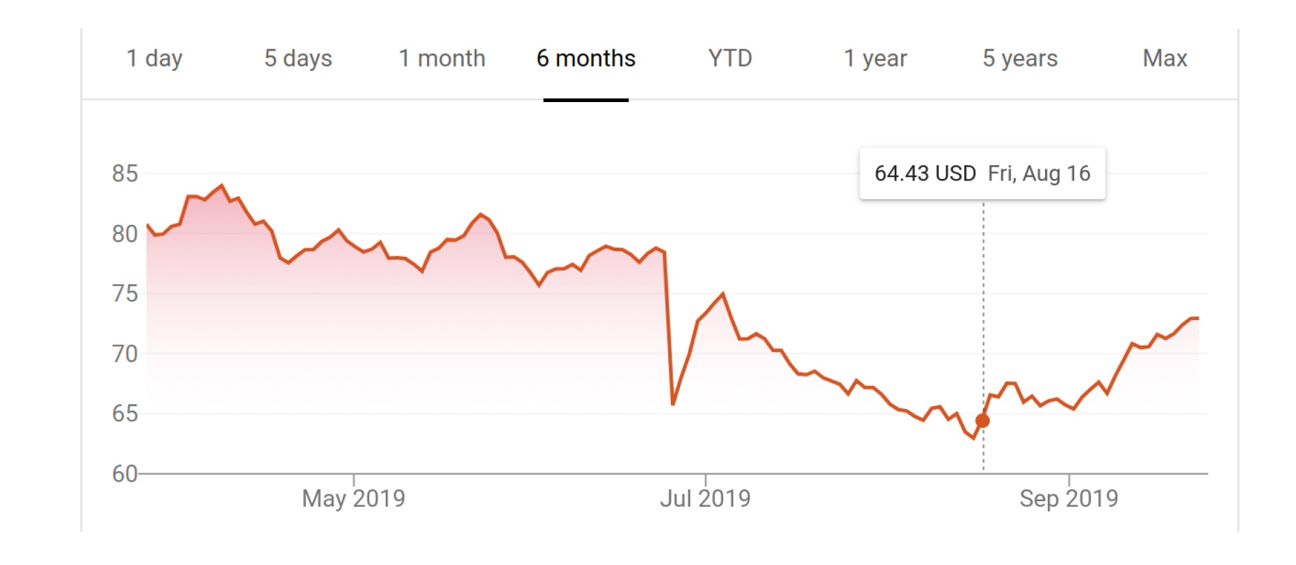
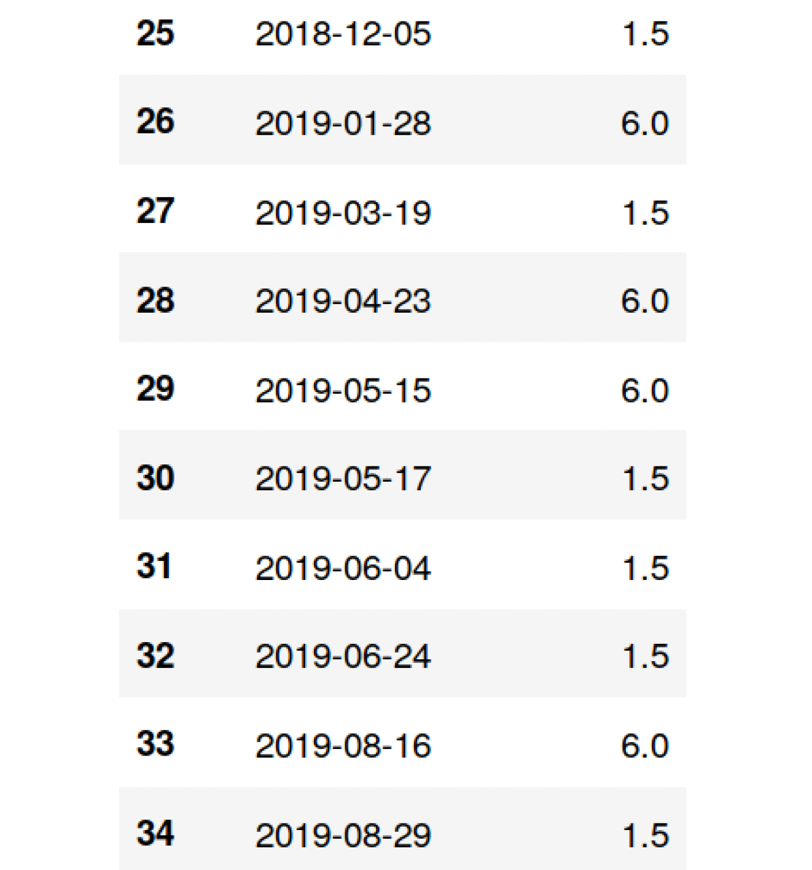
Case Example- ABBV AbbVie Inc
The historical performance
FDA announcement time series of ABBV

Slide 14
Conclusion of Portfolio
Key portfolio characteristics:
Since our strategy is based on the factor performance, our portfolio would remain the high value of those factors we selected. For example, it has high current-ratio, return-on-equity, inventory-turnover and be sensitive to FDA announcements. Also, it has a good performance for the combined factor.
The portfolio encounters a high spike at the middle of the test period which means our portfolio is profitable. However, as you can see in the final part of test period the portfolio has a big drawdown, we can fix this by adding the constrain when deciding the weights.

Slide 15
What we learned from these challenges
1. How to generate an event-driven factor
2. How to using web scraping techniques to grab the online data
3. How to evaluate the factors
4. How does a backtest platform work
5. The characteristics of event-driven factors
6. The situation of health care sector

Slide 16
Q&A
THANK YOU!

